Slide 1
E-COMMERCE APPLICATION
PREPARED BY :
GUIDENCE BY :
JIMMY RAMANI
HONEY RAI
SHIV PATEL
SANKET SUTHAR

Slide 2
TABLE OF CONTENTS
01
04
About the Project
Project Stages
02
05
Requirements
Sneak peek
03
06
References
Project Goals

Slide 3

DEFINITION
DIGI - Tech
We are making a system where people can buying e-commerce computers item.
It will contain all the necessary information like taking customers information for providing any ours information in future , customers interest items , proper invoices with taxes via online to both system and customers. In future we will also provide other e-commerce items with certain facilities.
It is online buying e-commerce products with interesting Design and easely accessible.
And also every month some % offeres....

Slide 4
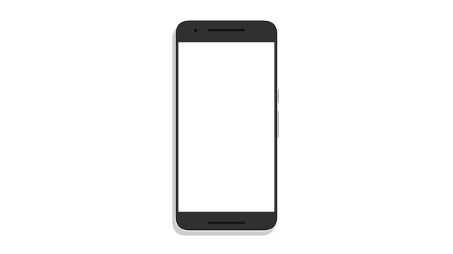



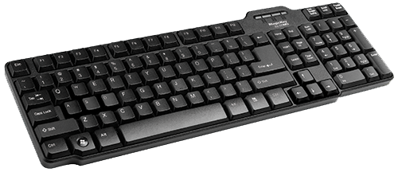
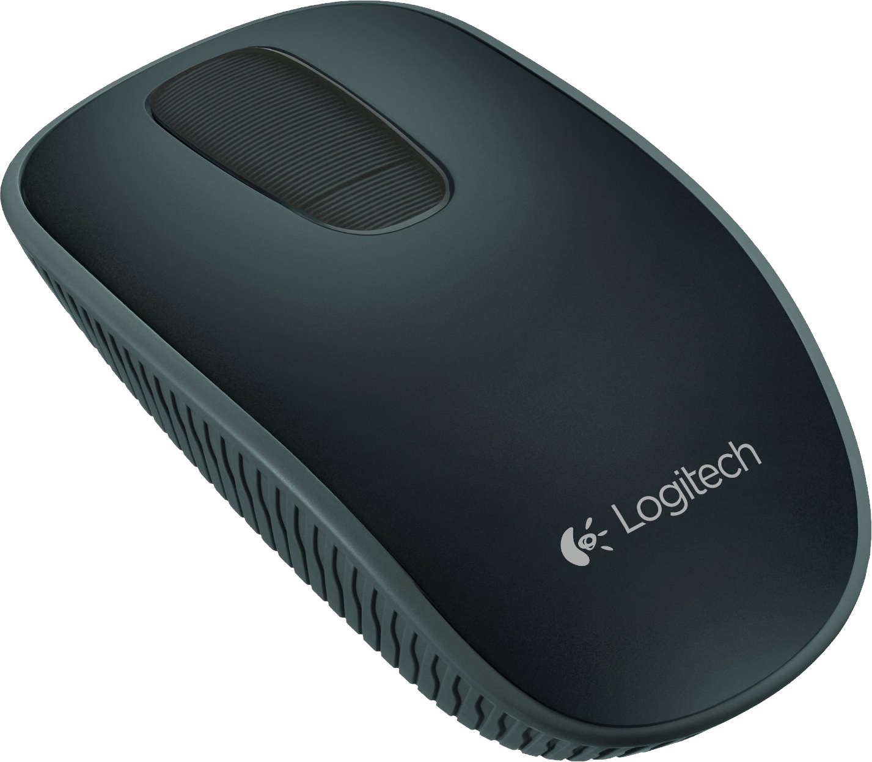
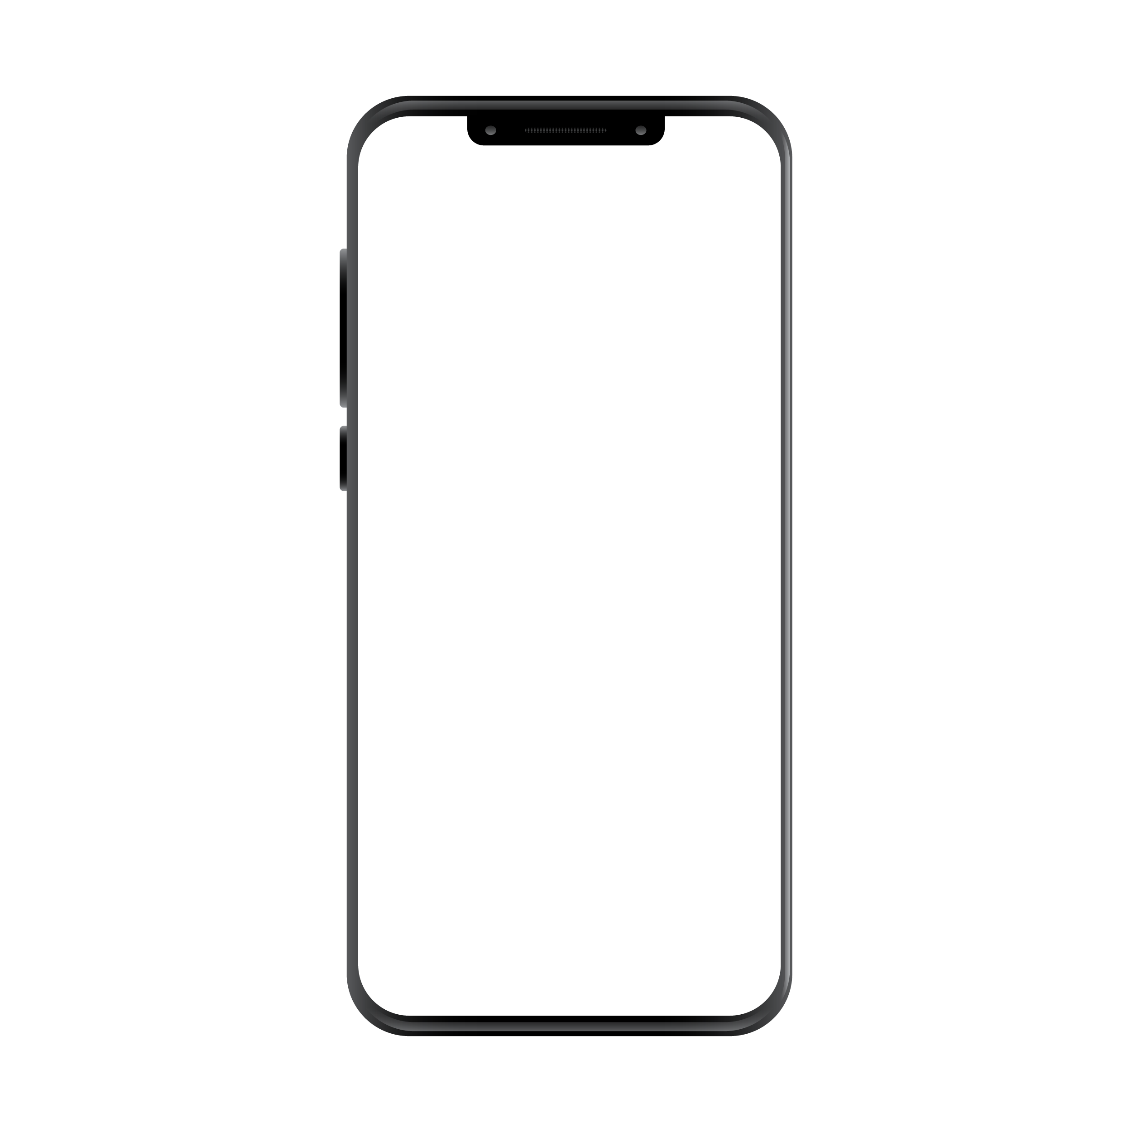
E-COMMERCE
PROJECT DESCRIPTION
LOGIN
SEARCH
ORDER TRACKING
As discussed above, it’s a system for all to find abouts e-commerce items and it’s buying like shoping & also enjoying interesting systems like music without much effort.
When the people interesting to buying product of e-commerce , They can refer this system for knowing about items information and also buying from here.
We will provide best exeperiece through over system and also every next time customers getting certain discounts.
We also generating lucky draws , Festival offers….
HOME
SHOP
BLOG
CONTACT
FESTIVAL QUIZ

Slide 5
PEOPLE’S HOPE
“Now Days people can’t get any
e-commerce items information from any simply . And also now people want to more and more discount .so they get it with very cheap price”

Slide 6
MAIN PAGE
SHOP COLLECTION DROPDOWN
FLOW-CHART
BLOG PAGE
CURRENCY , LANGUAGE , OREDER TRACKING
LOGIN PAGE
CONTACT PAGE
PRODUCTS PAGE 1
SEARCH , LOGIN , NOTIFICATION ,CART
HOME ,SHOP, BLOG ,CONTACT , FESTIVAL QUIZ
FESTIVAL QUIZ
PRODUCTS PAGE 2
SHOW CURRENT OFFERES
PRODUCTS PAGE 3
PRODUCTS DETAIL PAGE
SHOW CATAGORIES
MOBILE
Computors & Accessories
Audio
PRODUCTS PAGE 4
SHOW OFFERES PRODUCT
PRODUCTS PAGE 5
ETC.
SHOW COLLECTIONS
BLOG PAGE
SHOW BLOGS
FOOTER

Slide 7
FEATURES
INTRESTING SYSTEMS
EASSY TO ACCESS WITH DESIGNABLE
QUIZES
FESTIVAL OFFERES
SIMPLE TO LOGIN
EASSY TO CONTACT
NEW COLLECTIONS
E-COMMERCE ITEMS

Slide 8
MAJOR REQUIREMENTS
SOFTWARE
HARDWARE
HTML,
CSS,
JAVASCRIPT,
DRIVE,
GITHUB
LAPTOP, MOBILE
(FOR CREATING
& TESTING THE WEBSITE)
USER EXPERIENCE
INFORMATION
CLEAN, SIMPLE, RESPONSIVE - web pages for better UX
SELLING E-ELECTRONIC ITEM WITH FULL INFORMATION AND DISCOUNTS ALSO..
AND WITH OTHER FREATURES…

Slide 9
OUR GOALS
Get all the e-electronic item related information easily and quickly bying with certain discount
EXPANSIoN
USABILITY
Can be use easily on desktop
And installer
ASSIST
We want that our system reaches to maximum customers at any place

Slide 10
WEEK -1
WEEK -7
Created wireframe design, gathered information, and stated react course
Created database structure and connected with the frontend
PROJECT
STARTED
FINAL
VERSION
WEEK -3
WEEK -10
Divided screens among members and started working on it And Start Learning on Languages
Fixed bugs, test the website

Slide 11

FUTURE ENHANCEMENT
L
E
S
S
C
0
S
T
SECURE
EASY TO USE
SP. OFFERS
NEWLY E-ITEM LAUNCHED ON THE DAY
BEST DISCOUNTS COMPARE TO OTHER
GIFTS
This Photo by Unknown Author is licensed under CC BY-SA

Slide 12
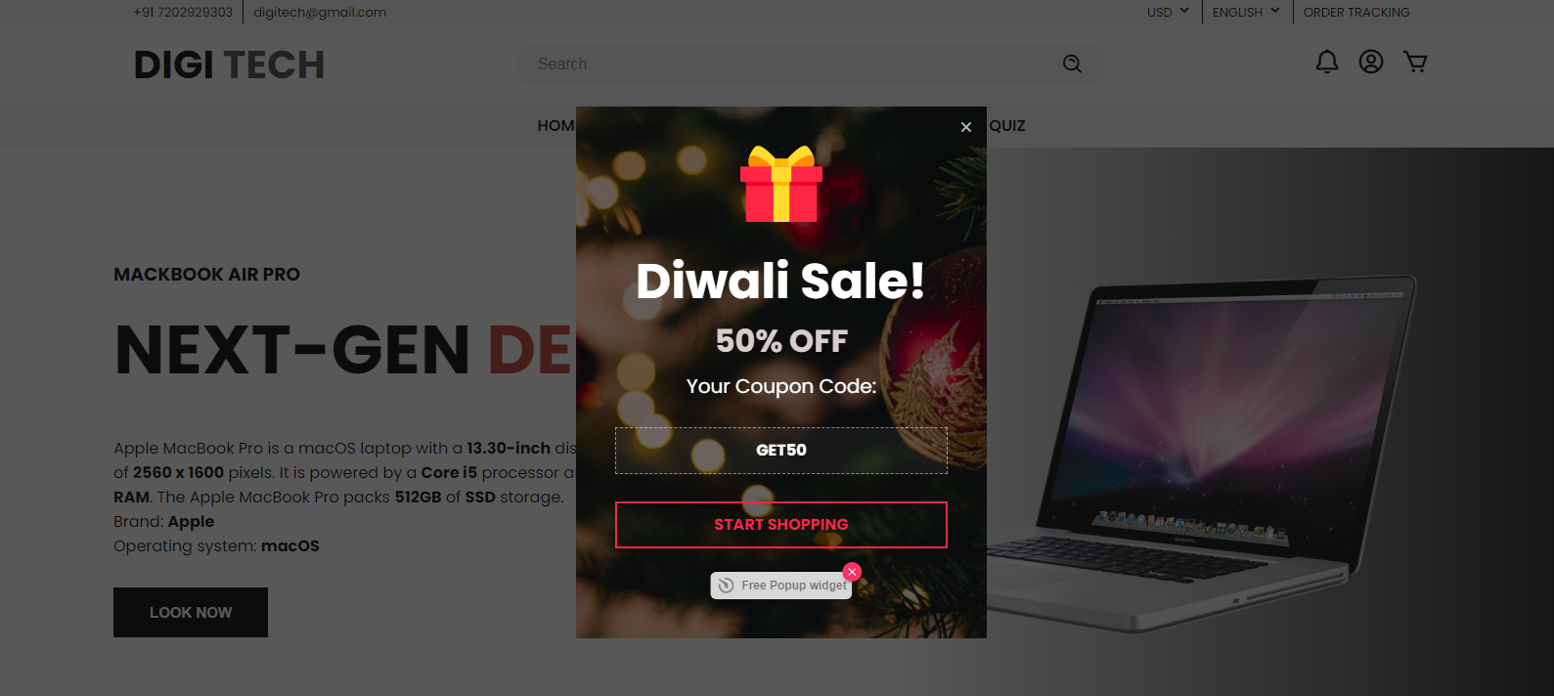
GALLARY
OF
OUR
WEBSITE

Slide 13
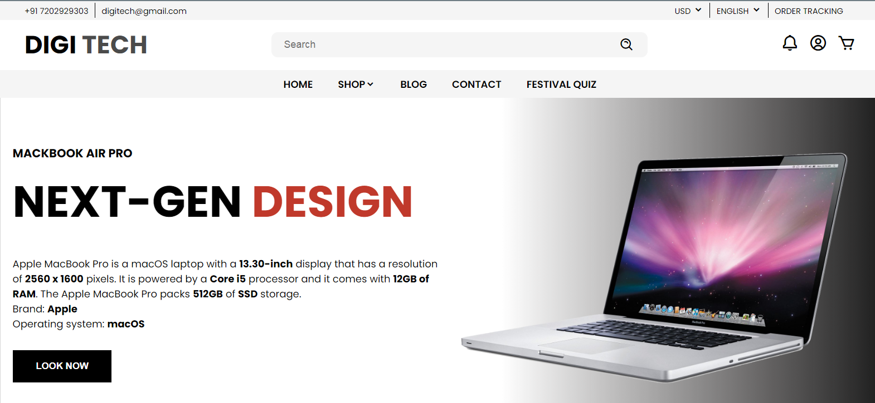
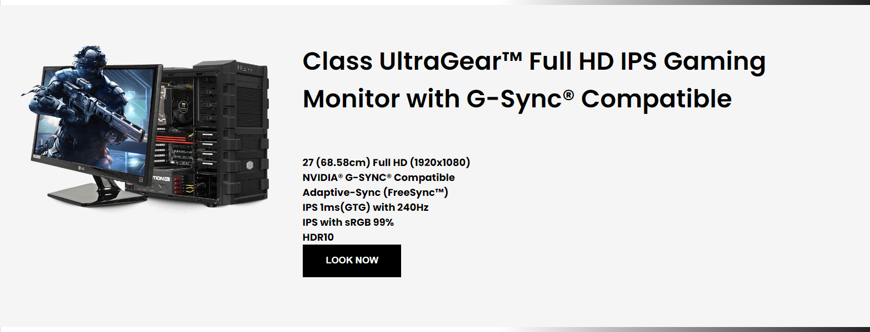
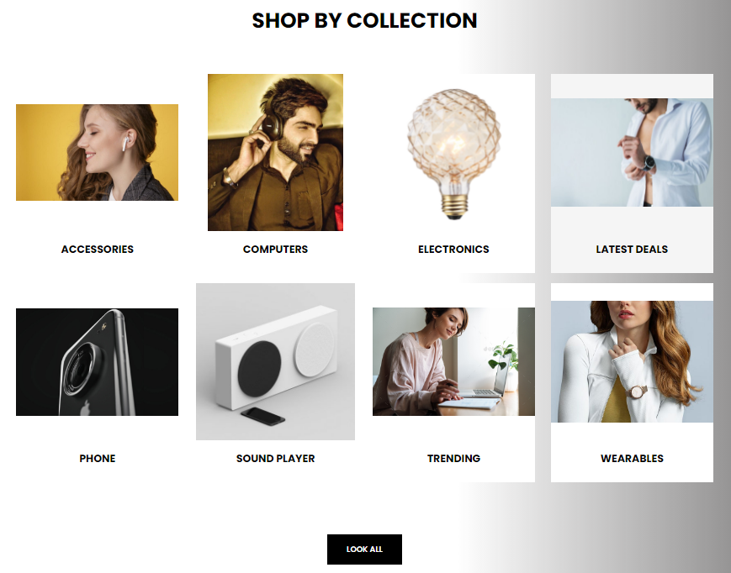
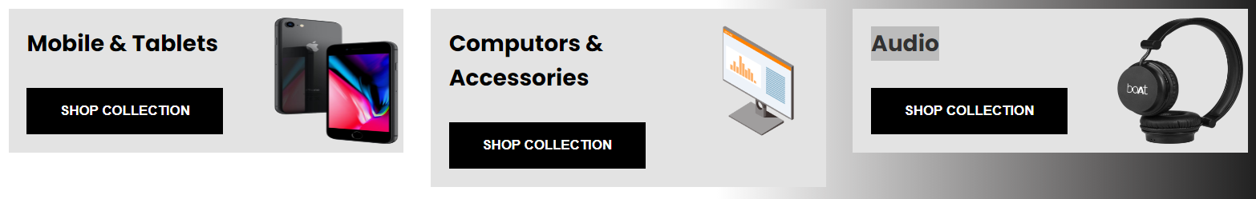
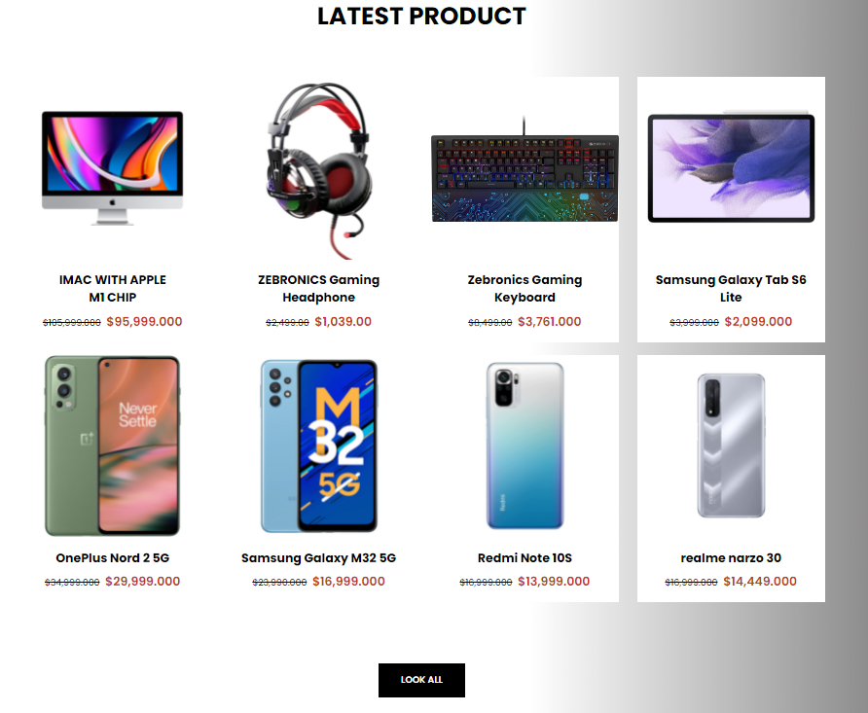
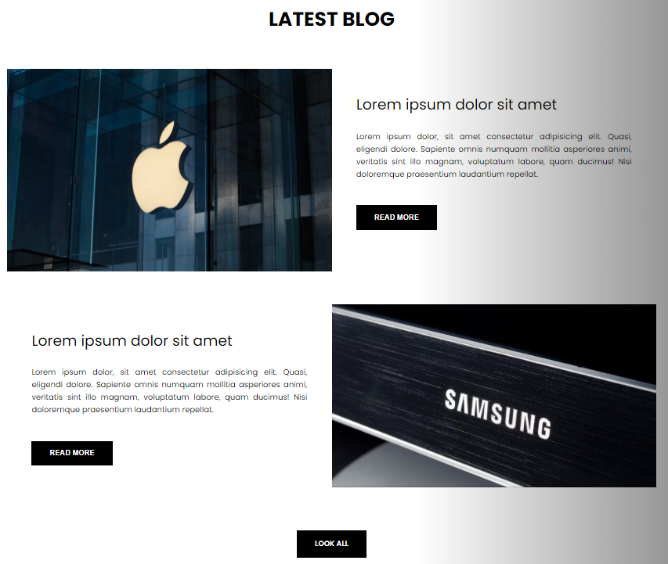
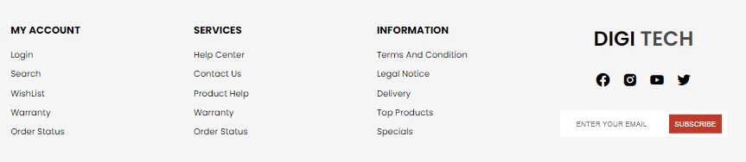

Slide 14
REFERENCES
Code With Harry Notes
Easy Tutorials
Programming Desire
Sakaos
Myntra , Amazon , FlipCart
Boot-Strap
Let Us C
https://www.shopclues.com

Slide 15
LANGUAGES
HTML
CSS
Java Scripts

Slide 16
SOFTWARE
Visual Studio
Chrome

Slide 17
THANKS!
CONTACT :
20IT120@charusat.edu.in
20IT119@charusat.edu.in
20IT113@charusat.edu.in

